Slide 1

Mobile Application Development, Fall 2021 Navigation and Multiscreen Apps

Slide 2
Today’s Agenda
Setting Some Goals
Working with Button
Working with TouchableOpacity
Introduction to React Navigation.

Slide 3
Setting Some Goals
So, we’re doing pretty well so far!
We know how to get components to show up the screen!
We know how to customize our components with props!
We’ve learned how to style our components with StyleSheets!
We know a little bit about JSX!
We’ve learned how to display lists of data!
Not too shabby!

Slide 4
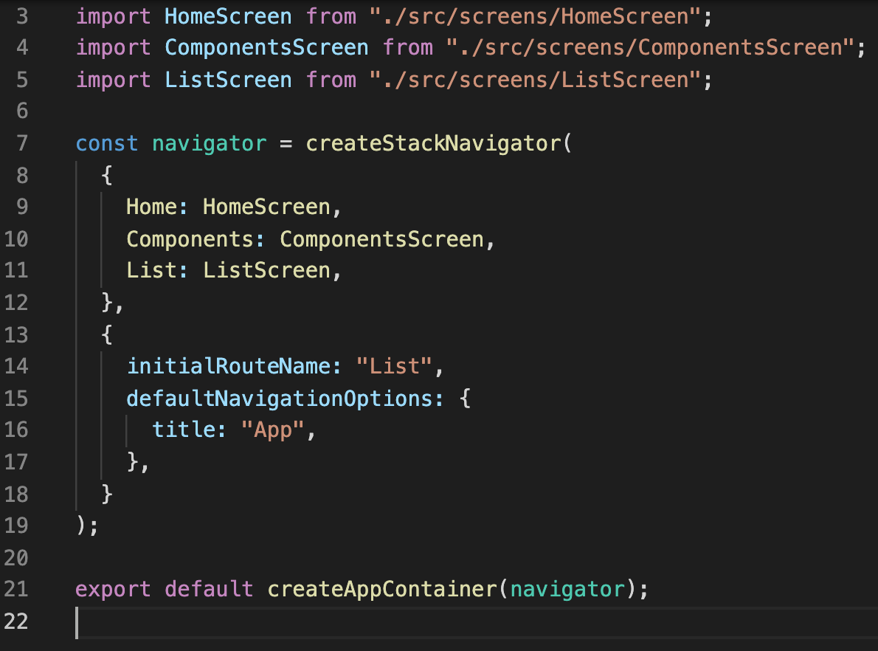




Setting Some Goals
But one thing that’s been a bit of a drag is that every time we create a new screen, we need to go back into App.js and edit which screen we start on.
Why is this a bummer?

Slide 5
Setting Some Goals
Well, probably for a few reasons, but here’s the one we’re focusing on today:
Currently, all of our apps can only be a single screen!
We haven’t learned how to make a single app with multiple screens in it yet!

Slide 6
Setting Some Goals
That changes today!
Today, we’re going to learn how to make an app that lets the user navigate around a multi-screen app!
And better still, we’ll let the user navigate around using buttons!
Buttons are very useful and ubiquitous!
But also not quite as straight forward to use as you might think!

Slide 7
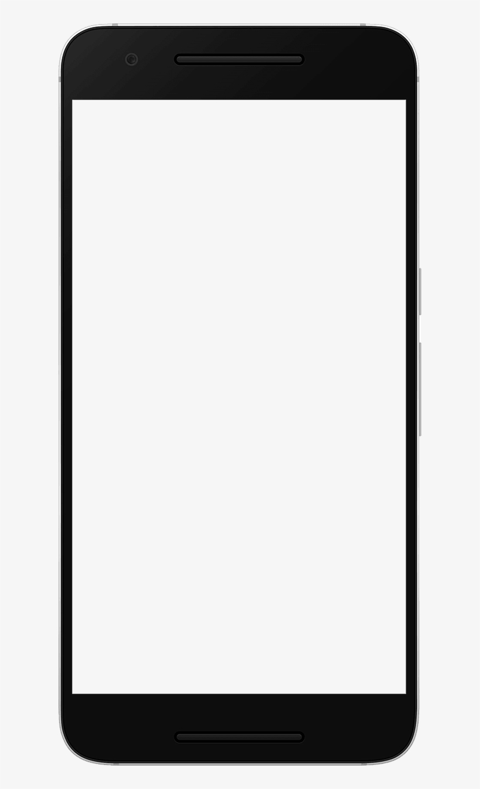
Setting Some Goals
This is the components screen!
I love mobile programming!!
It is the only time I feel alive
So the experience is going to look something like this.
We’ll make the new “home page” of our app have a bunch of buttons!
Clicking on a button will open up one of the previous screens we’ve made!
ComponentsScreen
ListScreen
Ben
Ted
Chris
Matt
James

Slide 8
Setting Some Goals
So we’ll learn more about navigation and buttons today, great!
BUT… really what I should be saying is that we’ll be learning about ”interactive components” today.
Because Buttons aren’t even the coolest way to handle the user pushing something!

Slide 9


Setting Some Goals
There are Button components, yes!
And you would import them just as you import Text and StyleSheet and View!
But even though the name Button is “self documenting”…
i.e., it has a descriptive name that gives you a good sense as to what it does.
i.e., “It is something that I can click on/press and then something will happen.”
It turns out its functionality is pretty limited!
The cooler way to handle user input is through the much-less-intuitively named component TouchableOpacity

Slide 10
Setting Some Goals
Originally, React Native *only* had TouchableOpacity!
But because that’s a pretty confusing name, eventually they added the Button component so that folks searching for buttons didn’t come up empty handed!
We’ll go over this in more detail later today. I just wanted to establish the link between the two early:
Button: simple ways to detect user’s pressing a button with limited customization.
TouchableOpacity: highly customizable way to detect a press on just about any component.

Slide 11
Today’s Agenda
Setting Some Goals
Working with Button
Working with TouchableOpacity
Introduction to React Navigation.

Slide 12
Working with Button
This is the components screen!
I love mobile programming!!
It is the only time I feel alive
So, again, this is what we are working towards.
I’m going to call the screen that has all of the buttons in it “HomeScreen.js”
In case you want to follow along at home and have things named the same thing I do.
ComponentsScreen
ComponentsScreen.js
ListScreen
Ben
Ted
Chris
Matt
HomeScreen.js
James
ListScreen.js

Slide 13
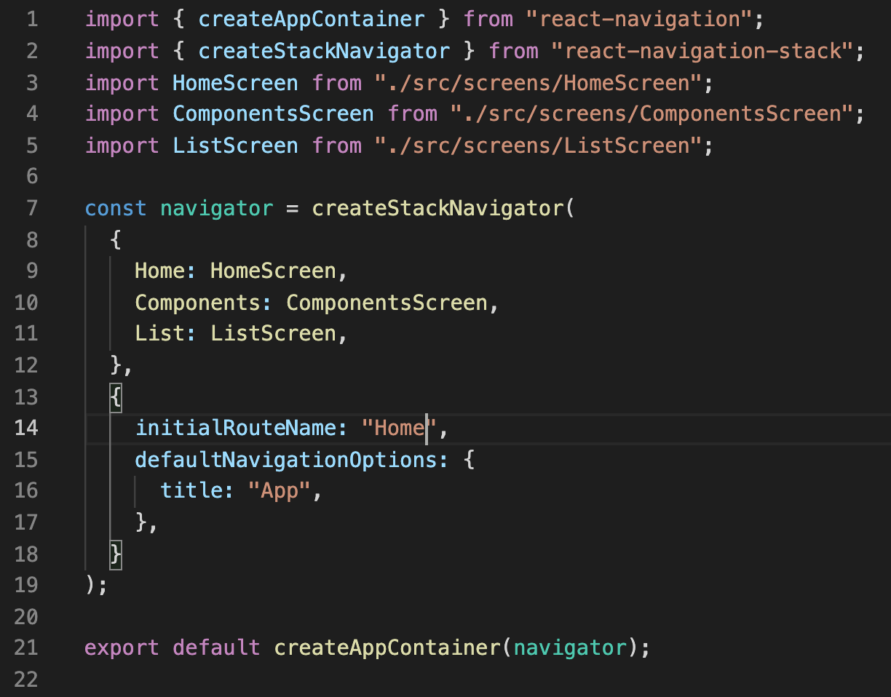

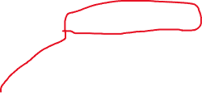
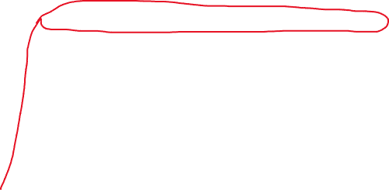
Working with Button
And so, hopefully not too surprising by this point…
If we want HomeScreen.js to be our “starting page” we need to specify that inside of App.js in the usual places.

Slide 14
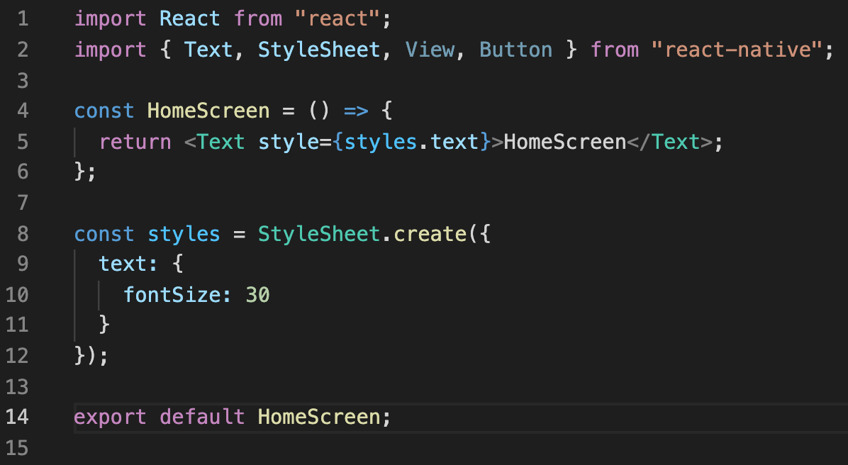

Working with Button
And similarly, here’s a nice starting point for the HomeScreen.js file.
There’s only one part of this that is new to us: the fact that we are importing the Button component.

Slide 15
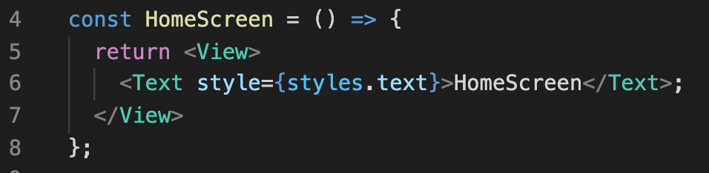
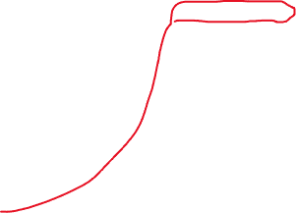
Working with Button
We know we want this screen to have multiple components, so let’s have our function return a View element, so we can group together multiple components.
Remember – we can only return one top-level element!
And react native wants its opening tag to be on the same line as the return keyword.

Slide 16

Working with Button
But did wrapping our Text component inside of a View accidentally screw anything up in this case?
YES! But what?
That ; at the end of line 6 is now being interpreted as text to render.
But it’s not inside of a Text element.
And so it will make React Native sad.

Slide 17
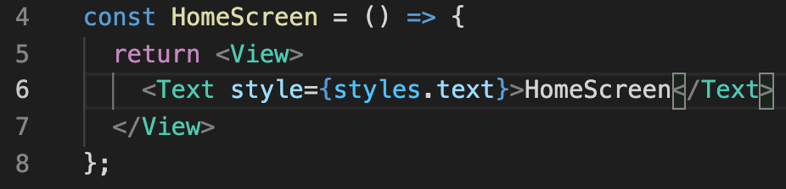
Working with Button
So we can just get rid of it!
We chatted about this last time, but now it is forever immortalized in slide form.

Slide 18
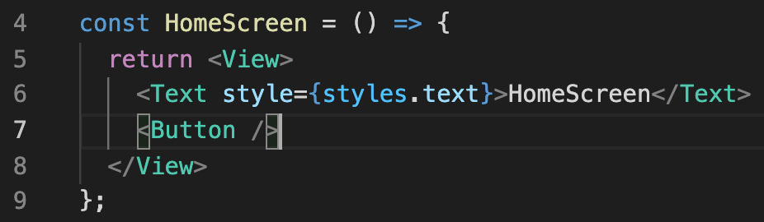
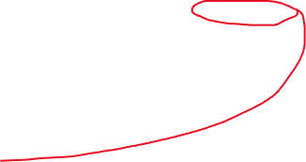
Working with Button
We’ll now add a Button component to the View as well.
Just like FlatList from last time, Button is self closing.
That is, the single <Button /> tag both opens and closes the button
You can tell by that ”/” at the end of the tag!

Slide 19


Working with Button
Just to really drive this home for folks who haven’t worked with HTML or tags before…
The image on the right is NOT what’s happening!
When it comes to Buttons, we don’t have an opening tag and a closing tag, with text sandwiched between them.

Slide 20
Working with Button
Instead, if we want to display text with a Button component, we do so using a prop!
Specifically, we’re make use of the title prop.
The title prop will take in a string, and it is what will display on our button.

Slide 21
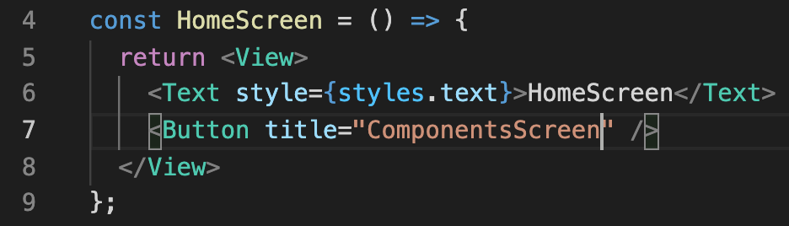
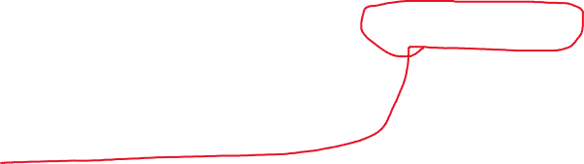
Working with Button
So then, adding the Button might look a little something like this!
Note that for this prop, we are just passing in the string directly, with quotation marks!
Nearly every other value passed into props is done with the { } as we’ve seen, but strings don’t have to be!

Slide 22
Working with Button
So this code here would produce something like this.
The Text element will display the words HomeScreen
And the Button will say ComponentScreen.
BUT… what will happen if we click the button?
HomeScreen
ComponentsScreen

Slide 23
Working with Button
Nothing, of course!
If you want something done, ya gotta do it yourself!
Real quick, any thoughts as to what we might need to do/add/change to give our button some interactivity?
HomeScreen
ComponentsScreen

Slide 24
Working with Button
If you said “use another prop!” then you are correctamundo!
The Button component has another built in prop called onPress
Spelled exactly like that, with that camel case capitalization. Will be unhappy if you deviate from that!
onPress specifies what should happen if… the button gets pressed!

Slide 25
Working with Button
More specifically: we pass in a function to onPress. That function will get called every time the button is pressed!
This function is an example of a handler. A handler basically specifies “I am what should happen in case a certain event takes place.”
Here, the event in question is the onPress event.
And with that, we’ve come full circle! We’re defining the function that “handles” what should happen when the user presses the button!

Slide 26
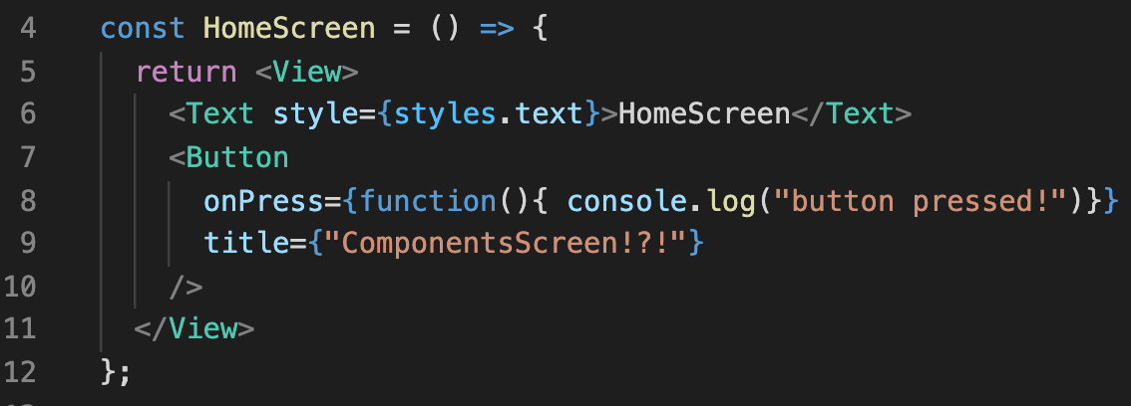
Working with Button
Now, let me show you not only the world’s simplest onPress function… but also something that will change your life if you’ve never used it before…
My friends: I present to you the majesty which is
console.log()

Slide 27
Working with Button
But, ah, first! The sanity check!
As promised, we are giving onPress a function.
Using the function() keyword way instead of the => way – both work just fine! Just switching it up!
No parameters for the function.
And the body has this console.log() thing…

Slide 28
Working with Button
console.log will print out a String to the “console”
It is a fantastic way to sanity check that *your* perception of reality matches the computer’s
E.g., find out if your code is executing!
Print out the values of variables!
And so much more!
But in this world, what is the console?

Slide 29
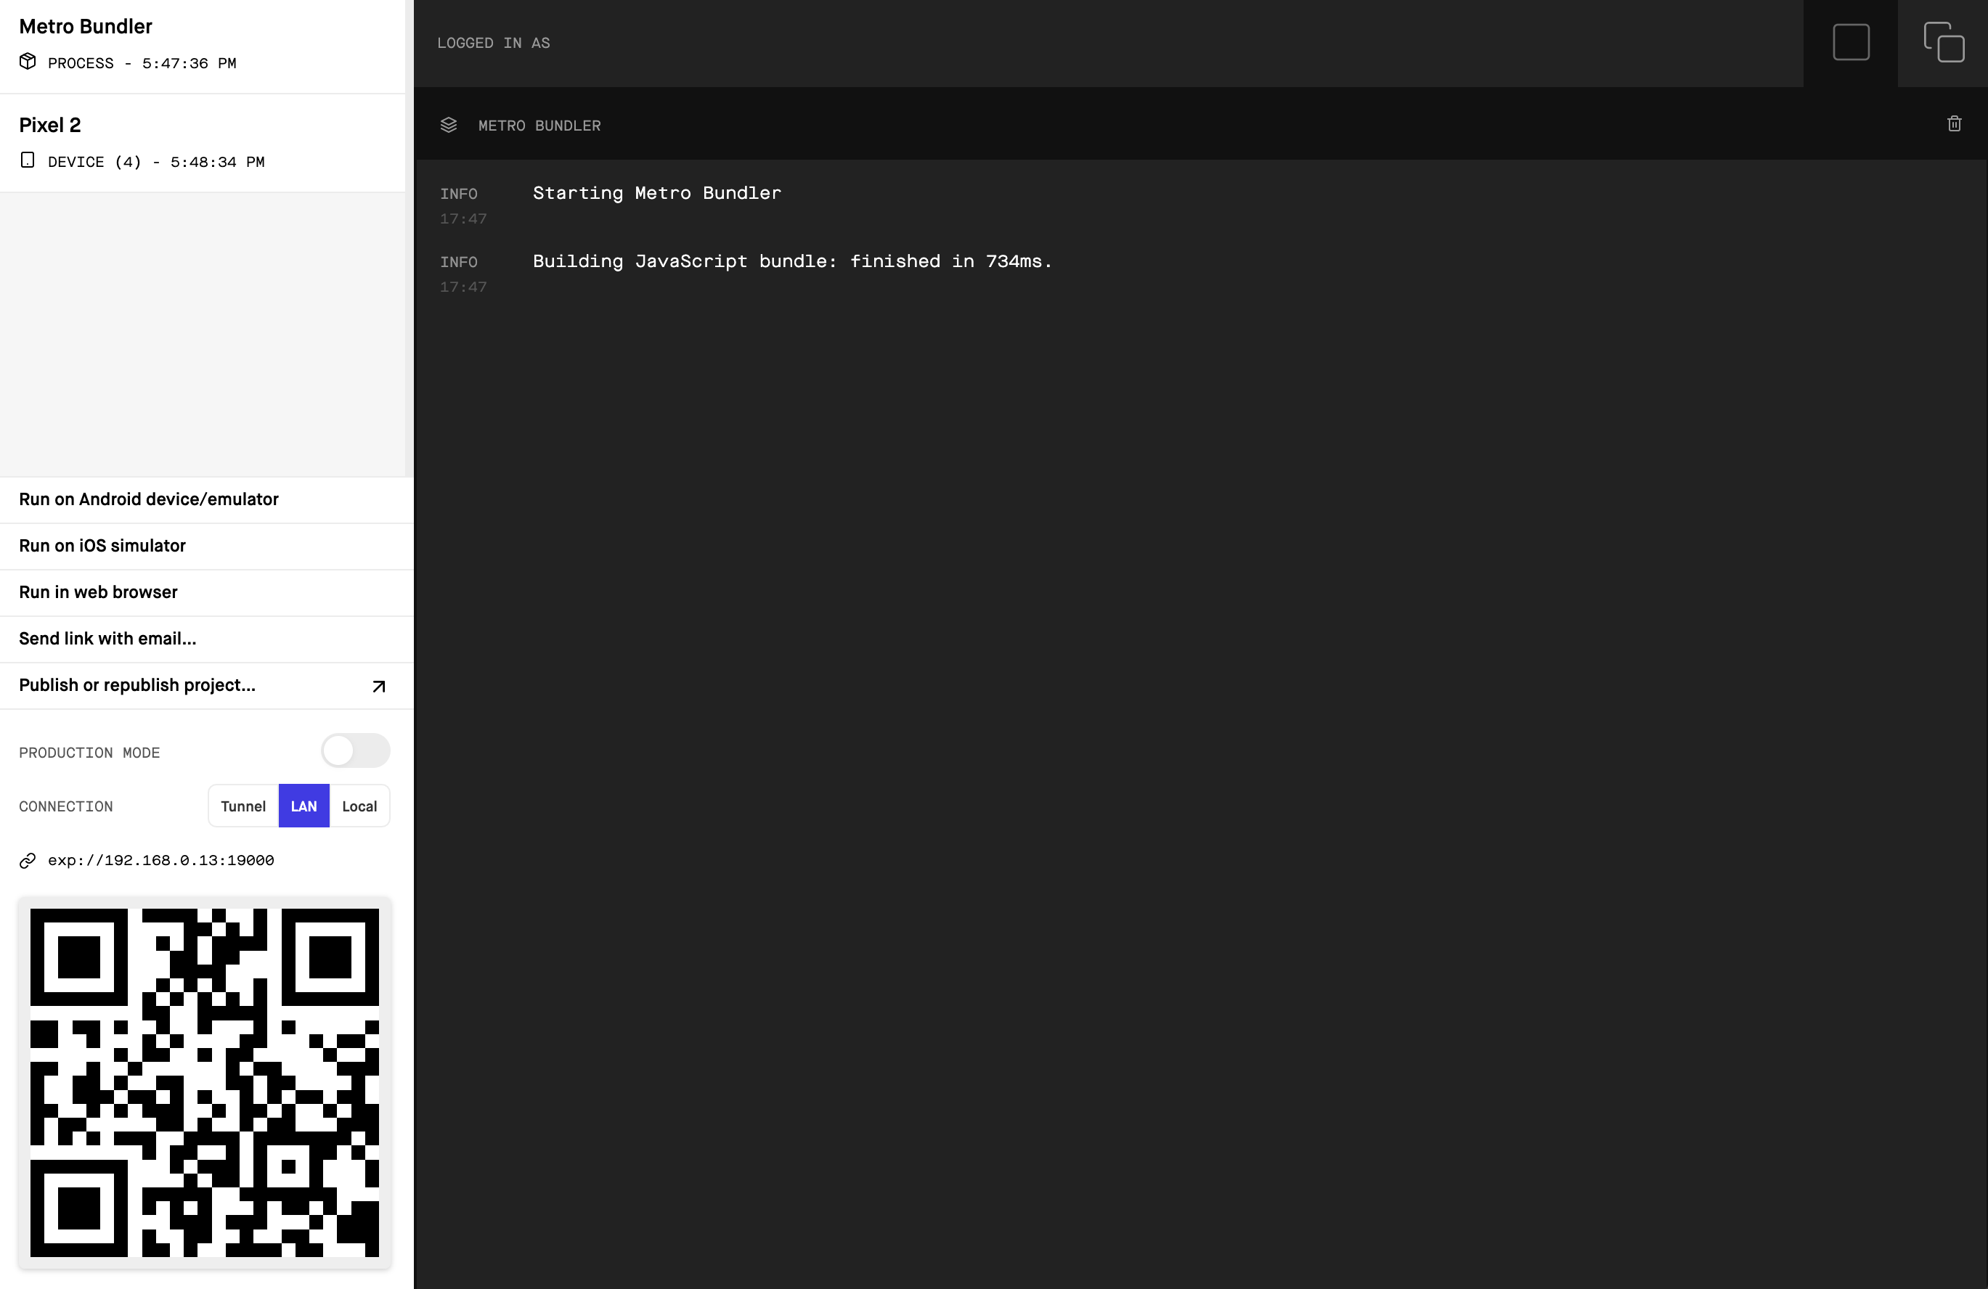


Working with Button
There’s a couple of places to check!
One is your browser with the metro bundler!
Click on those double windows in the corner!

Slide 30
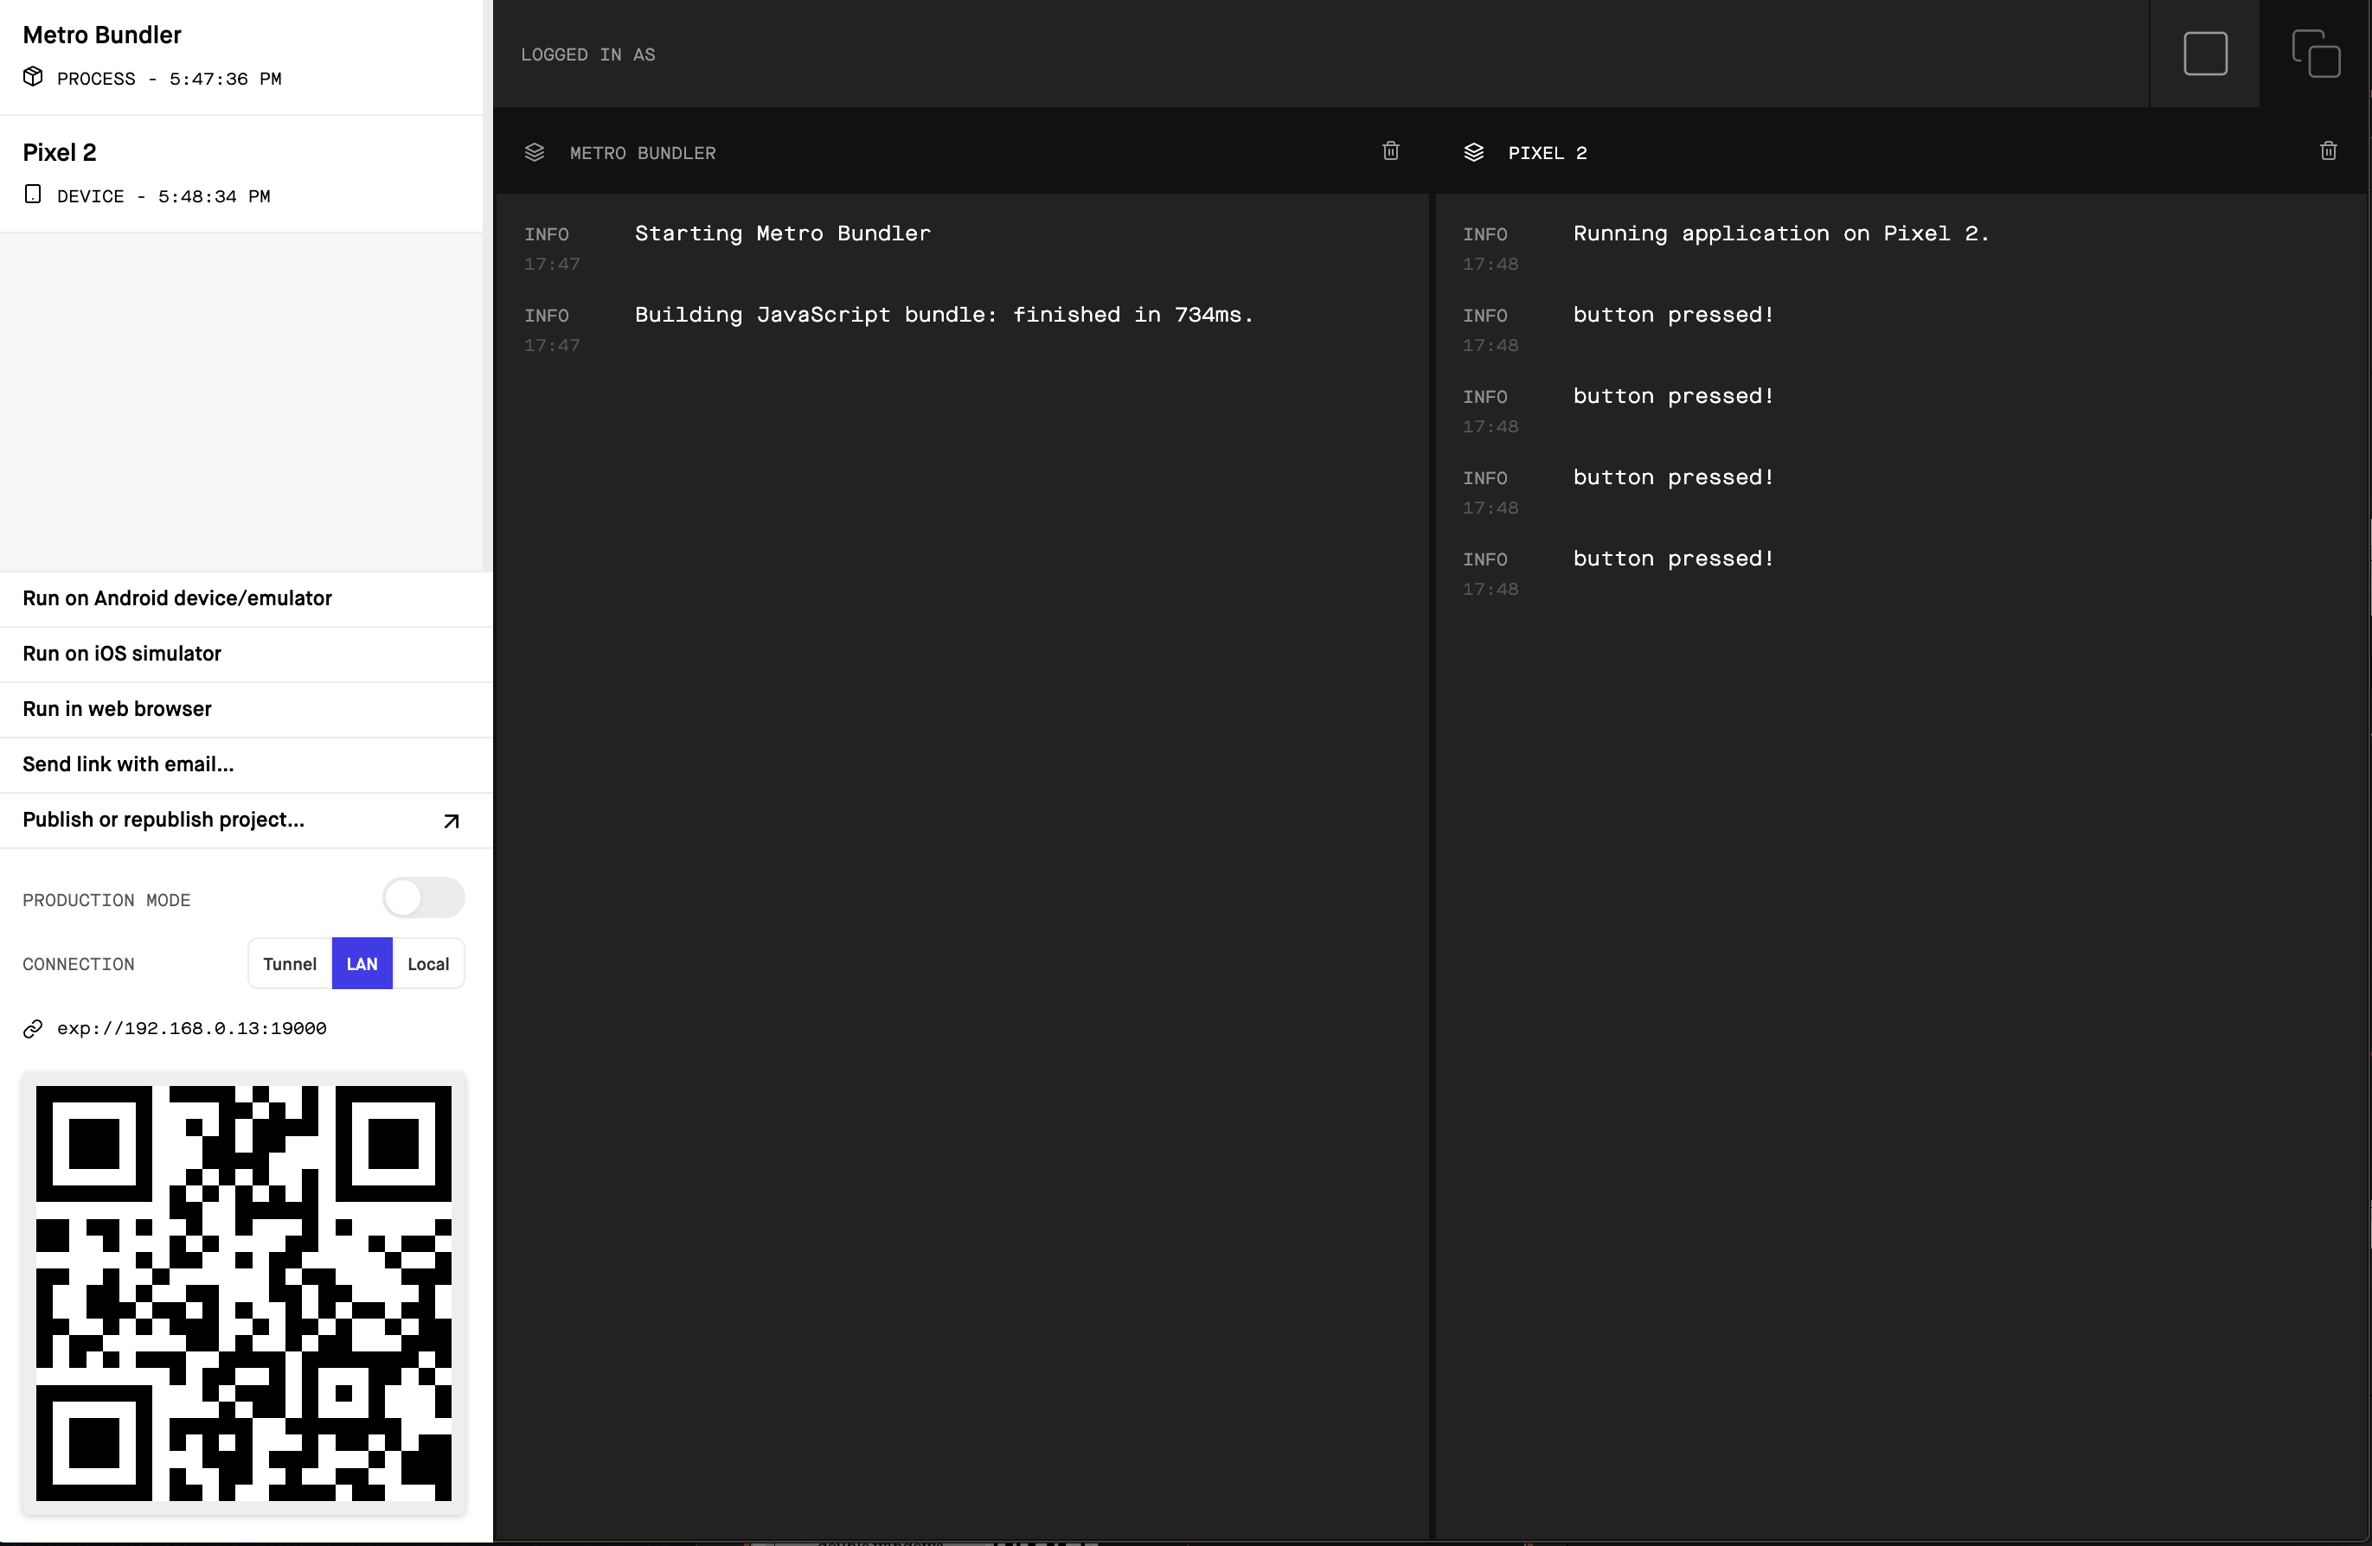

Working with Button
It will open up a lovely little console, that will have all of your console.log() messages!
You can see I clicked the button four times!

Slide 31
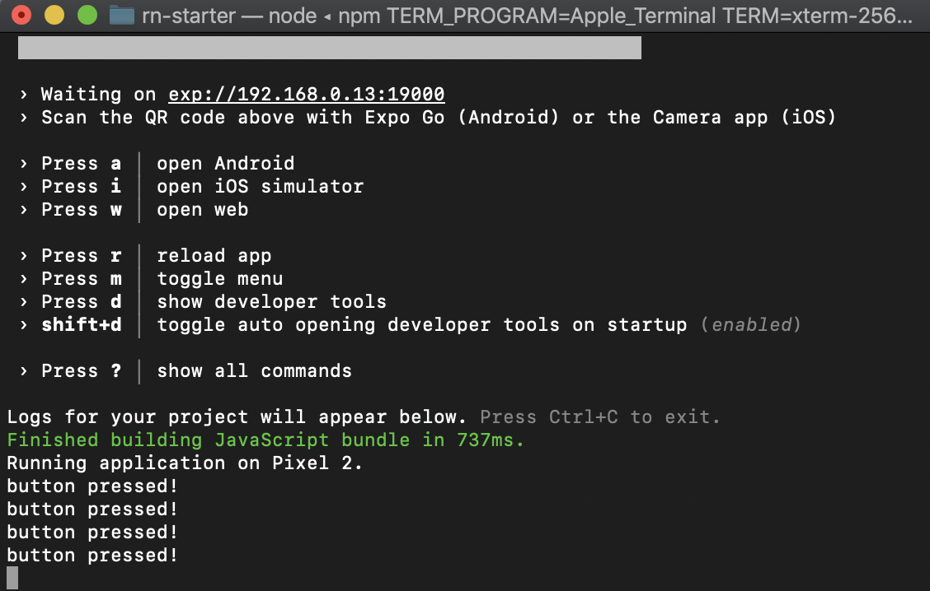
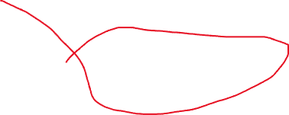
Working with Button
You should also be able to see the same messages on your Terminal or GitBash!
It’s the same four button press messages!

Slide 32
Working with Button
So, awesome!
We have interactivity!
That’s actually a pretty huge step, even if we aren’t doing anything particularly thrilling with it yet!
Before we start covering *thrilling* interactivity, let’s take a quick peek at the other way we mentioned: TouchableOpacity

Slide 33
Today’s Agenda
Setting Some Goals
Working with Button
Working with TouchableOpacity
Introduction to React Navigation.

Slide 34
Working with TouchableOpacity
Because TouchableOpacity is more customizable, odds are you’ll be using it more than you’ll be using Button.
So let’s get acquainted with it!
Let’s add it to the same screen as our existing button!

Slide 35
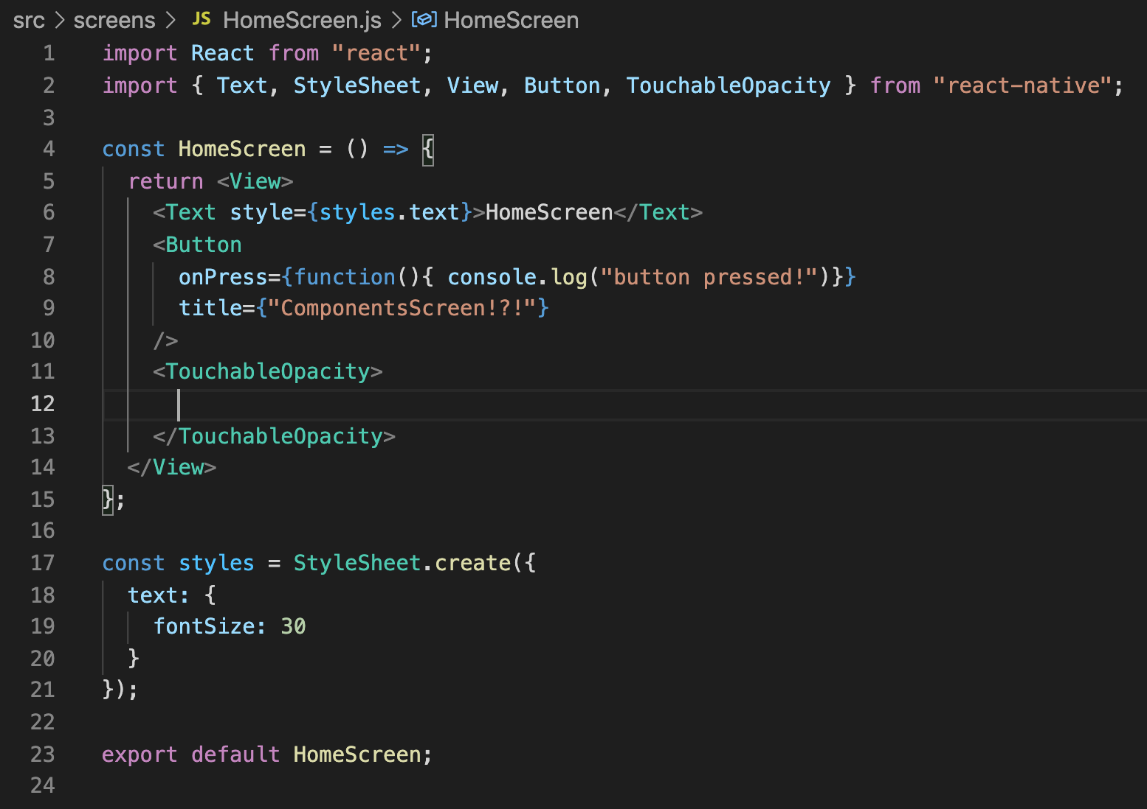
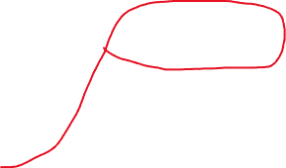
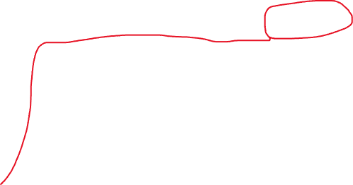
Working with TouchableOpacity
So, take 20 seconds to identify the two differences between this and what we had before…
We’re importing a new thing!
And we are using it! Though currently empty.

Slide 36

Working with TouchableOpacity
And note that TouchableOpacity is *not* self closing.
i.e., it has a separate opening and closing tag.
Let’s fill those guys in with stuff!

Slide 37
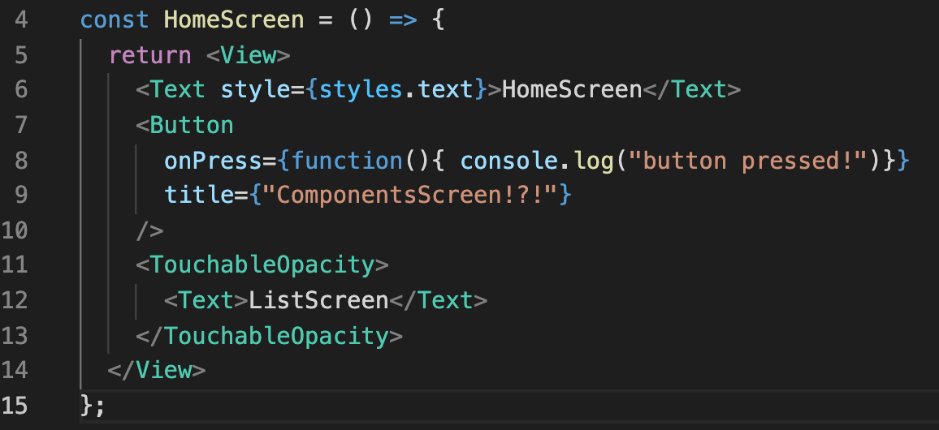
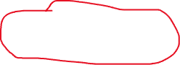
Working with TouchableOpacity
Like, something like this!
All we did was fill it in with a Text element!
We could have filled it in with other elements too, if we wanted!
And now that Text element is going to be “clickable”

Slide 38
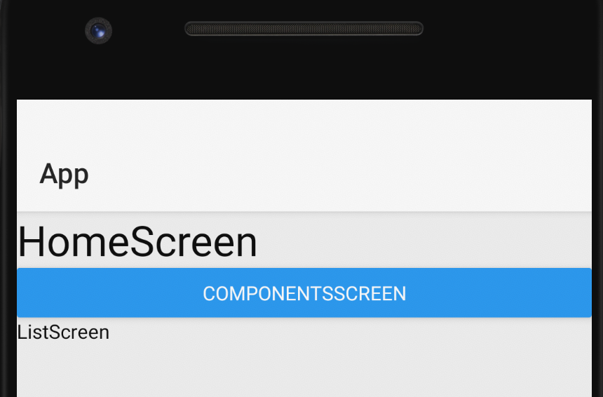
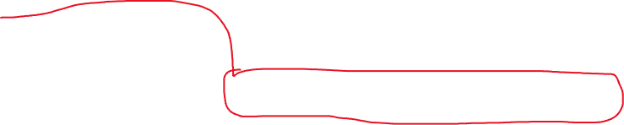

Working with TouchableOpacity
So if we were to boot up the app, it would look a little like this!
Here’s our Button element. Note that it has the default Button styling for your OS of choice
This is Android in this photo.
And here’s our TouchableOpacity element.

Slide 39
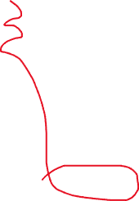
Working with TouchableOpacity
The Text element isn’t styled (we didn’t specify a StylesSheet), and TouchableOpacity doesn’t offer any default styling.
So it looks a little plain right now.
BUT! If you were to try clicking/pressing ListScreen, you would see it “fade out” in the way that buttons do when you push them!
FYI: Opacity basically refers to how transparent something is or isn’t.
High opacity == opaque == not transparent.
Low opacity == less transparent.

Slide 40
Working with TouchableOpacity
So what we lose out in default styling, we get back in flexibility!
We could put basically *any* element inside of a TouchableOpacity element, and then it will get this little bit of fading out feedback automatically.
However, right now, fading is ALL that happens. How might we actually get it to *do* something when we push it?

Slide 41
Working with TouchableOpacity
Basically exactly how we got the Button component to work!
With the onPress prop!
Note: this prop goes on the TouchableOpacity element, not on the elements between the TouchableOpacity tags.

Slide 42
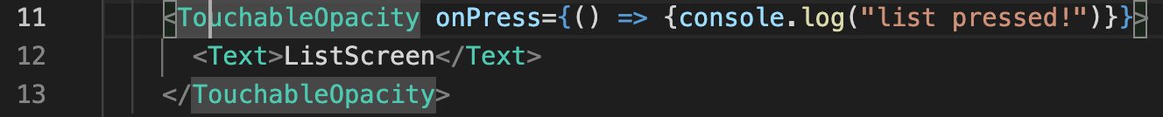
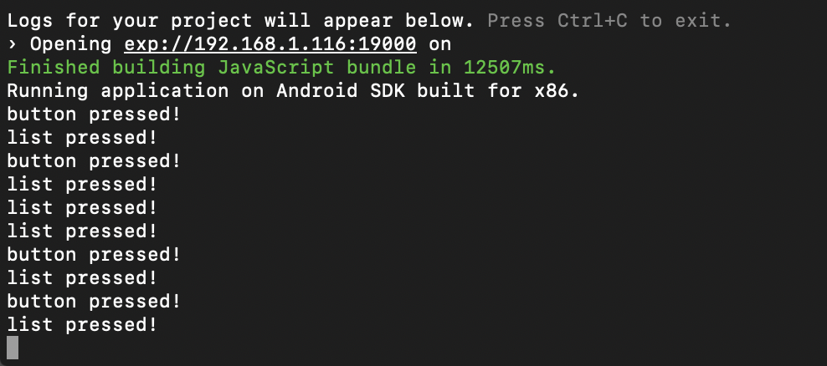
Working with TouchableOpacity
So, onPress might look a little like this!
Giving it an arrow function, making use of our good friend console.log()
And now if you click/press it, you should see nice debug messages! I clicked on both the button and the list a few times here!

Slide 43
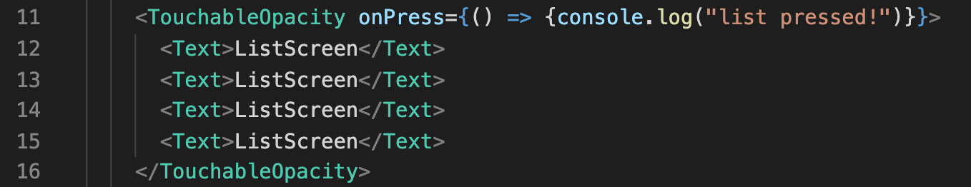
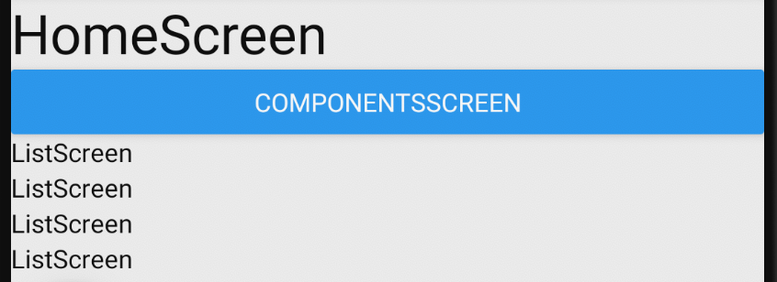
Working with TouchableOpacity
And just to drive this point home: we could have multiple elements nestled inside our TouchableOpacity
Doing this would have all of these text views still be treated as one “button” as it were.
Clicking on *any* of those text elements will fire off the same “onPress” event (here, that would mean printing “list pressed!” to the console).

Slide 44
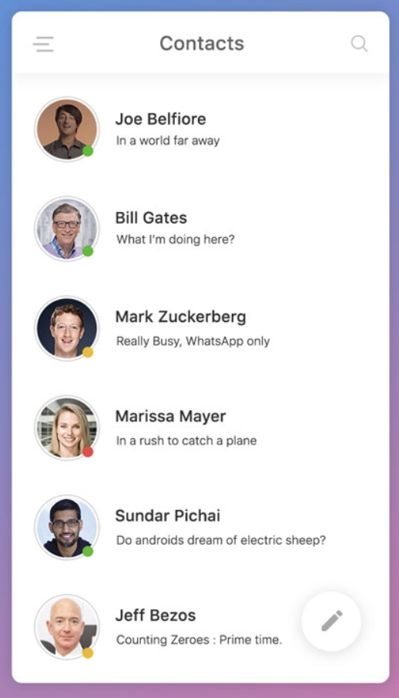
Working with TouchableOpacity
Now, ah, clearly, just having the same text repeated a bunch of times is unlikely something you’d ever need/want.
But remember some of the fancier lists we were looking at!
With this contact list on the right, it seems like each item in the list has (at least) three elements
An image for their face
A text element for their name
Another text element for their status.
(also maybe a fourth image for those green/yellow/red circles).
It would make sense that clicking on *any* of those elements should do the ”same thing” right?
E.g., touching their name, picture, or status update all gives the person a call.
As we just saw, TouchableOpacity would let us do that easily!

Slide 45
Working with TouchableOpacity
So, cool! This is good! We have achieved interactivity.
But like, as great as console.log() is, that’s much more thrilling for us as developers than it will be for users.
Let’s fulfill the dream we originally promised today! Let’s officially make our app MULTISCREEN with the power of React Navigation.

Slide 46
Today’s Agenda
Setting Some Goals
Working with Button
Working with TouchableOpacity
Introduction to React Navigation.

Slide 47
Introduction to React Navigation
This is the components screen!
I love mobile programming!!
It is the only time I feel alive
So we’ve seen this a few times now!
By this point we now have a lovely home screen with things we can click on.
But how do we get it to switch screens when we click?
ComponentsScreen
ListScreen
Ben
Ted
Chris
Matt
James

Slide 48
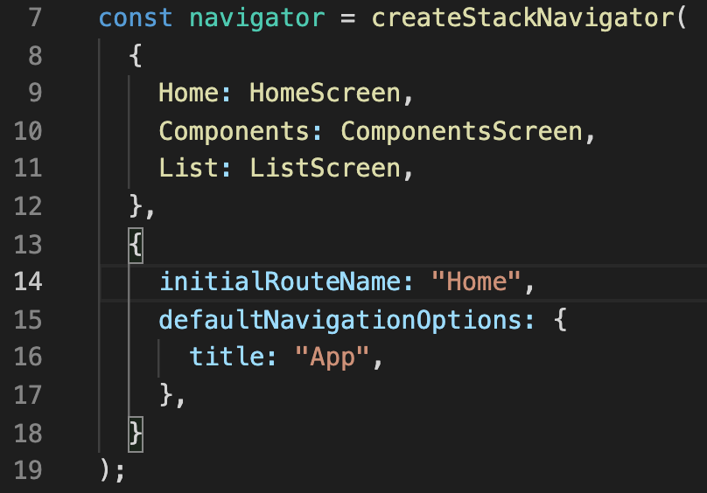

Introduction to React Navigation
I’m hoping that some of your brains are heading towards the App.js file.
We haven’t really gone into much detail, but we’ve worked with this function every time we want to change our “start screen”
If the function name is to be believed, we are creating a Stack Navigator.
So what then, is a Stack Navigator?

Slide 49
Introduction to React Navigation
Well, simply put, the Stack Navigator helps decide what gets rendered to the screen.
We tell it what all of the options are! In this case right now, there’s three different screens to choose from.
React Navigation
Stack Navigator
Home Screen
Components Screen
List Screen

Slide 50
Introduction to React Navigation
BUT – it doesn’t just decide what to render… it also has the power to pass down props to the screens as well!
Now, this is actually slightly new/cool! How does this differ from what we’ve seen before?
Props
React Navigation
Stack Navigator
Home Screen
Props
Components Screen
Props
List Screen

Slide 51
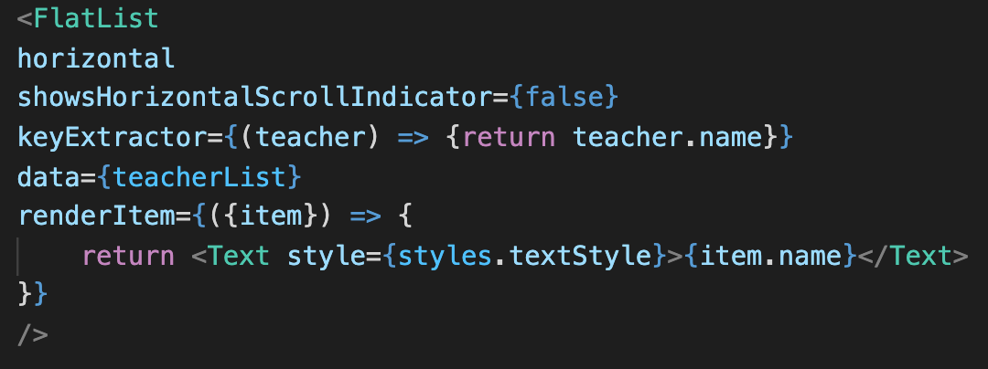
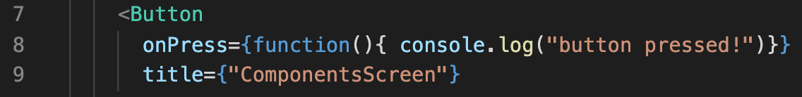



Introduction to React Navigation
Before we were using props for components made by the React Native folks!
FlastList had keyExtractor, and data, and renderItem
Button had onPress and title
Text had style
These were all props defined by others!

Slide 52
Introduction to React Navigation
But HomeScreen and ComponentsScreen and ListScreen were all components that WE made!
This means that we’ll be able to define props to customize/configure our very own components!
And the Stack Navigator will help us to specify them!
Props
React Navigation
Stack Navigator
Home Screen
Props
Components Screen
Props
List Screen

Slide 53
Introduction to React Navigation
This is also how we’ll be able to specify which screen we want to render. But before we do that, let’s see what it looks like to send props down to one of our own custom components.
Props
React Navigation
Stack Navigator
Home Screen
Props
Components Screen
Props
List Screen

Slide 54
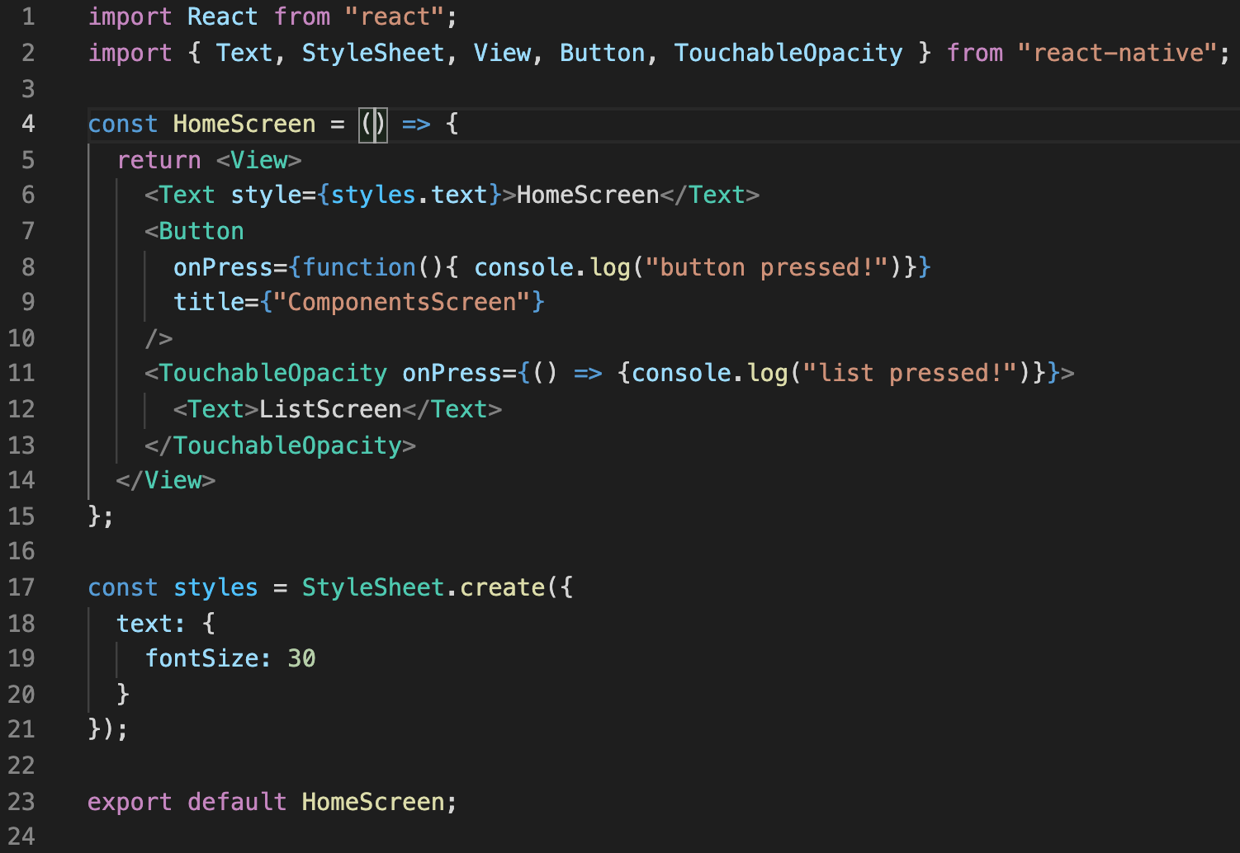
Introduction to React Navigation
Good news! It’s not too bad!
Here are the four parts of our component file, yeah?

Slide 55
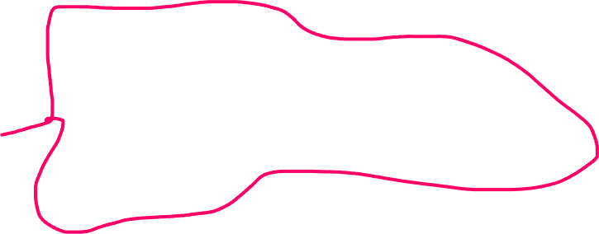
Introduction to React Navigation
And this second part is where we define a function that returns our component?

Slide 56
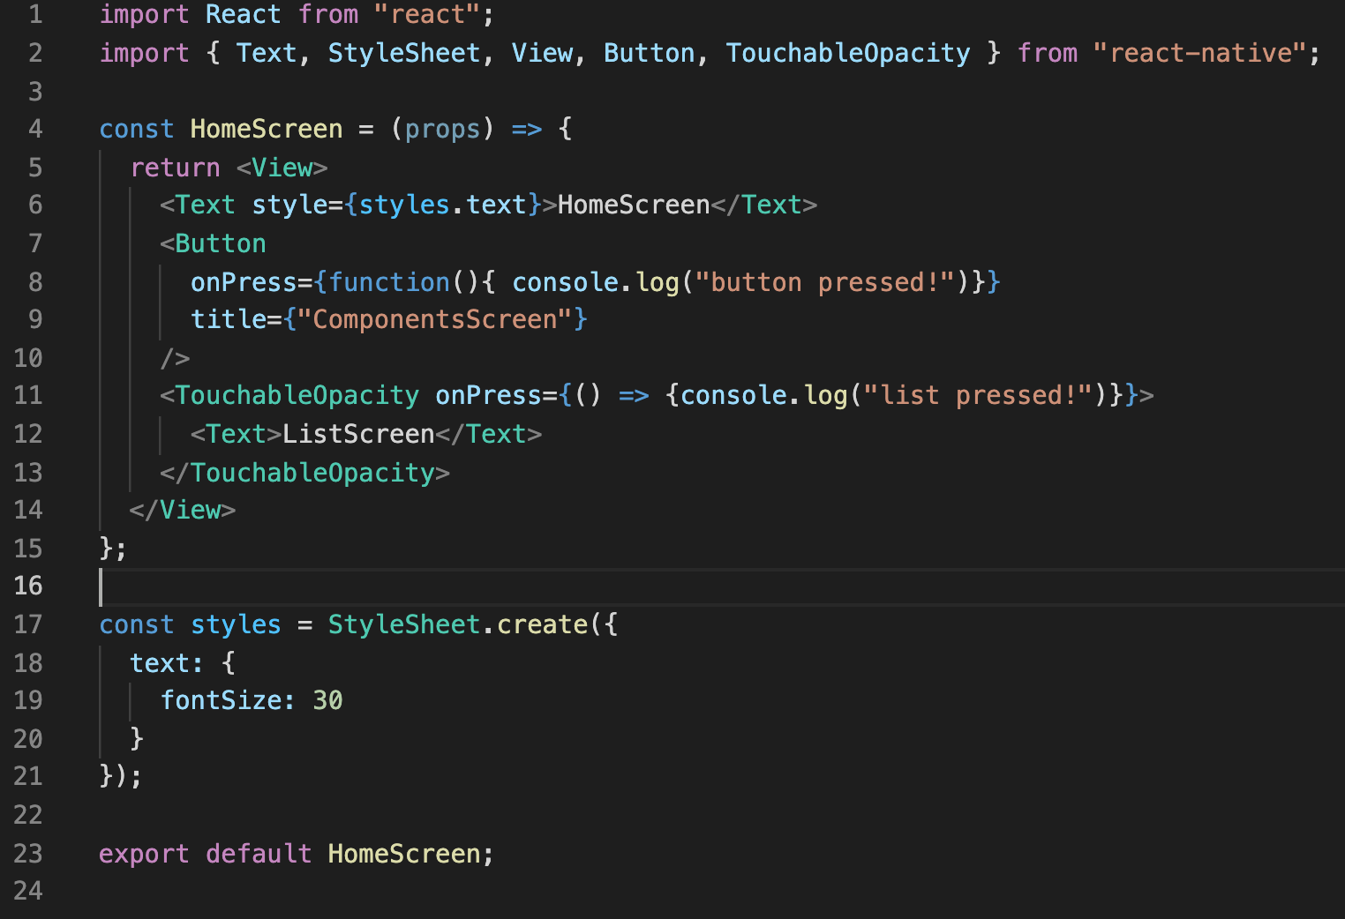
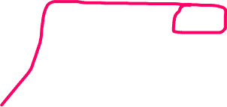
Introduction to React Navigation
All you need to do is specify something in the parameter list!
The first parameter will store whatever props you end up passing in!

Slide 57
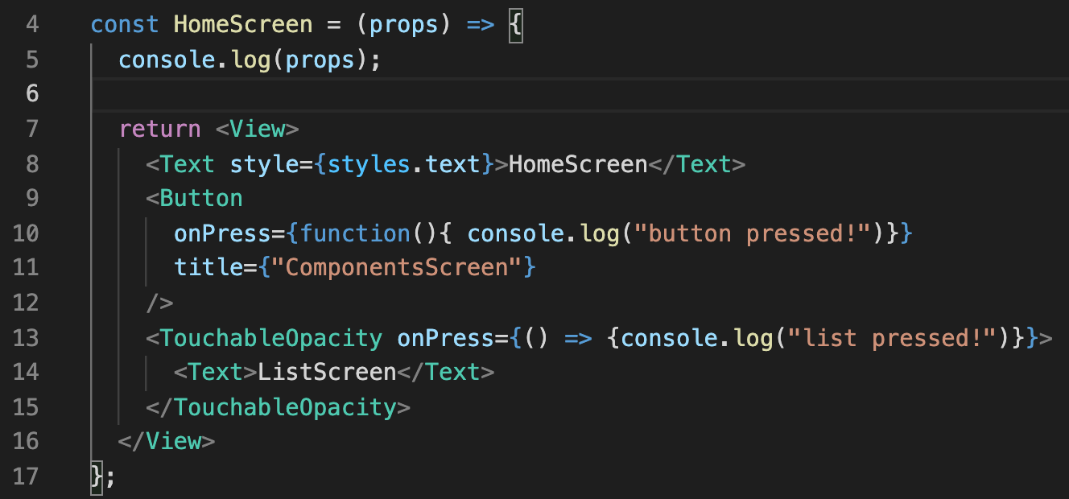

Introduction to React Navigation
And as it turns out, just by default, *a ton* of props are already automatically getting passed in!
We can verify this for ourselves by printing them out with console.log()
(yes, we are allowed to have additional lines beyond the return statement in our function body!)

Slide 58
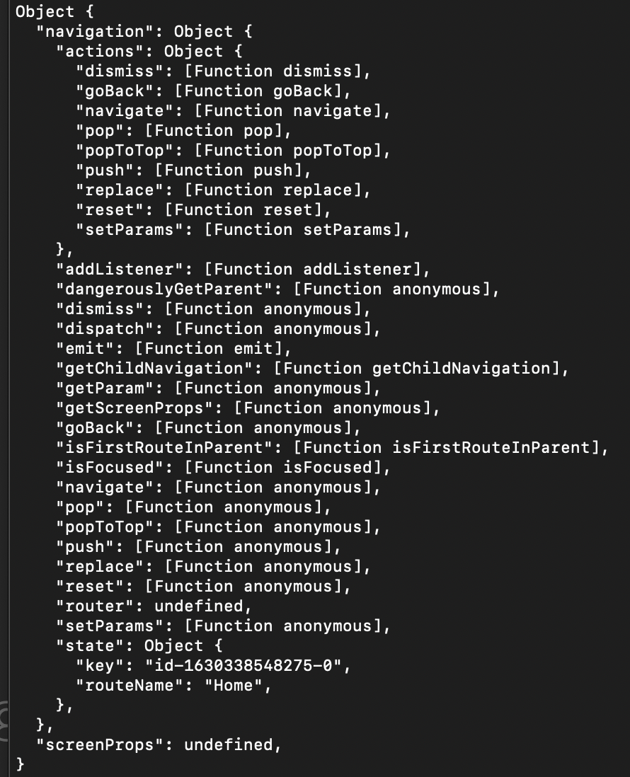
Introduction to React Navigation
If you add that console.log() file and save, your screen should re-render…
And as such, when you look at the log, you should see something like this!
The props variable is an Object that has a TON of things inside of it (including other objects!)
Let’s break it down!

Slide 59
Introduction to React Navigation
As promised, there is this big ol’ Javascript object here.
And we’ve seen many times by now. Javascript objects are just a bunch of key : value pairs!
And this one is no different!

Slide 60
Introduction to React Navigation
Next is the navigation Object.
You can see that nearly everything in this props object is actually a part of this navigation Object.
“screenProps” being basically the only exception to this, at the very bottom.

Slide 61
Introduction to React Navigation
Inside of the navigation object is the actions object.
And remember how in JavaScript functions are first class objects? Inside of actions, we basically are storing a bunch of functions.
E.g., the “dismiss” key is holding the dismiss function.
The goBack key is holding the goBack function
pop is holding pop
popToTop is holding popToTop
Etc. etc.

Slide 62
Introduction to React Navigation
And then, in addition to having the “actions” object, the navigation object also has a lot of functions of its own!

Slide 63
Introduction to React Navigation
AS well as this ”state” Object, that has a “key” and a “routeName” properties.
So, there’s a ton of stuff here! Definitely don’t worry about memorizing this any time soon!
Just wanted to give you a feel for what we’re working with/remind you all about objects again.

Slide 64
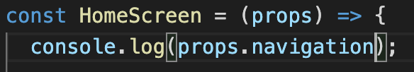
Introduction to React Navigation
And so if you wanted to, since so much of this just lives inside of the navigation property…
If you wanted, you could test what life is like if you only printed out the contents of the navigation property…

Slide 65
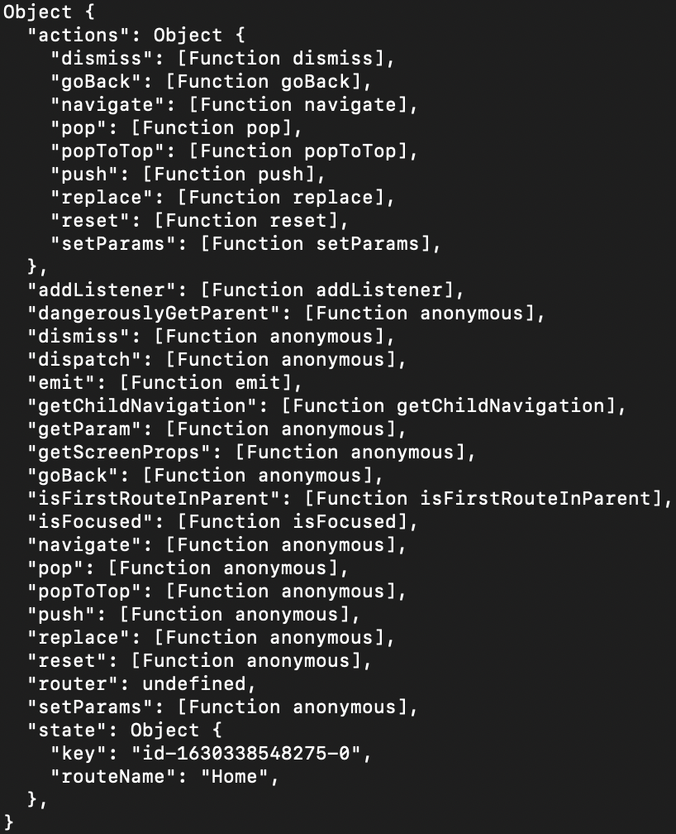
Introduction to React Navigation
And it would be what you would expect!
i.e., mostly the same!
Content of props printed
Content of navigation printed

Slide 66
Introduction to React Navigation
It should also be noted that not *every* react component is going to have a Navigation property.
We are getting it because our component is specifically being rendered by that Stack Navigator, which is giving us all of this stuff behind the scenes.
Content of navigation printed

Slide 67
Introduction to React Navigation
OK – I know there’s a lot here and it might be a bit overwhelming.
BUT!
If you had to make a guess as to which property here might be helpful to help us switch between screens of our app, what might it be?
Content of navigation printed

Slide 68

Introduction to React Navigation
A lot of these are reasonable guesses!
But let’s take a look at this navigate property…
We can see just based on this that it’s a property that is storing a function.
But what does that function do?
Well I’ll tell you!
Content of navigation printed

Slide 69
Introduction to React Navigation
The function stored in the navigate property takes in a String…
And if that string matches one of our different route names in our App.js file…
Then the Stack Navigator will have that component display on the screen immediately!

Slide 70
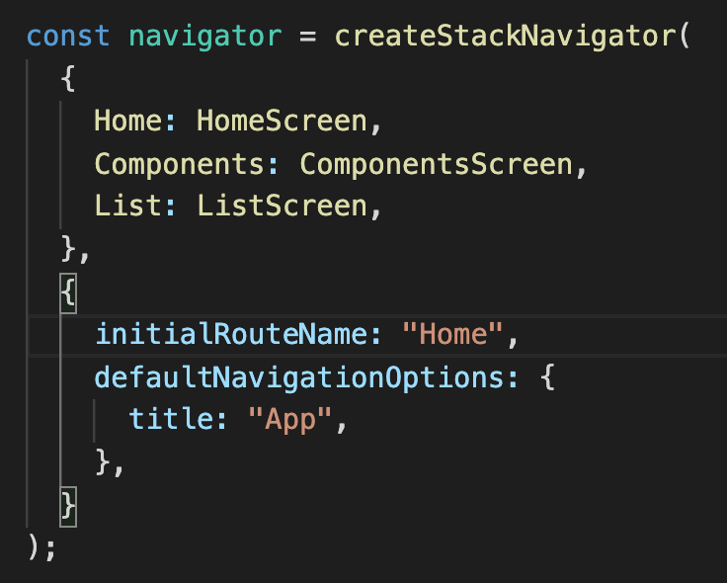

Introduction to React Navigation
So, to be clear, this is what I mean by the route names in our App.js file
We have three of them here:
Home
Components
List
So if we call the navigate function, with, say, the string “List”…
The stack navigator will render the List component to the screen!

Slide 71
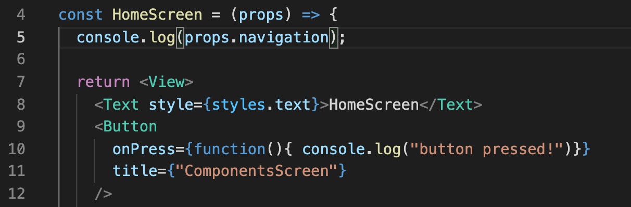

Introduction to React Navigation
So with that, a mini challenge!
What would you need to change to the onPress prop of our button element, to make it so that clicking on the “ComponentsScreen” button actually took the user to the Component Screen?

Slide 72
Introduction to React Navigation
Ends up being something like this!
First, we just deleted the console.log() statement.
We want to invoke the navigate function.
And as we discussed that function is nestled deep within our props object.
Specifically: props had an object called navigation, and the navigation object had the property navigate.
And we specifically pass in a string to the function that matches the route that we want.
And in my personal App.js file that I showed on the previous slide, the route name for the components screen was simply “Components”

Slide 73
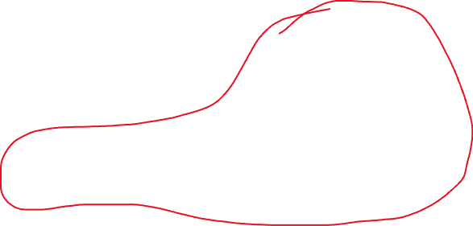
Introduction to React Navigation
This is the components screen!
I love mobile programming!!
It is the only time I feel alive
And just like that, this part is done!
Now if you click on the ComponentsScreen button, it should in fact, open the Components Screen!
ComponentsScreen
ListScreen
Ben
Ted
Chris
Matt
James

Slide 74
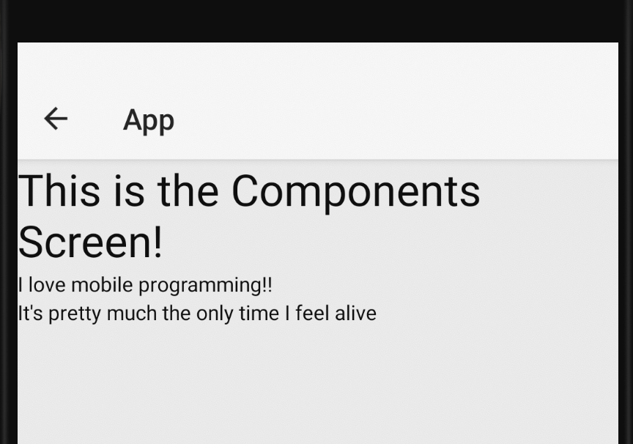

Introduction to React Navigation
And better yet, React Navigation provides us with a nice gift that we’d have to add by hand back when this class was Android only!
This is the components screen, i.e., where we end up when we push the button.
And notice how it gives us this nice back button for free!
Clicking it takes us “where we came from” which in this case, will be our HomeScreen component!

Slide 75
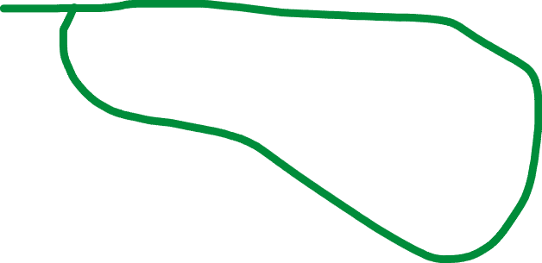
Introduction to React Navigation
This is the components screen!
I love mobile programming!!
It is the only time I feel alive
Great, we are almost there!
All that’s left is finishing up the second piece right here!
How do you think we do it?
ComponentsScreen
ListScreen
Ben
Ted
Chris
Matt
James

Slide 76
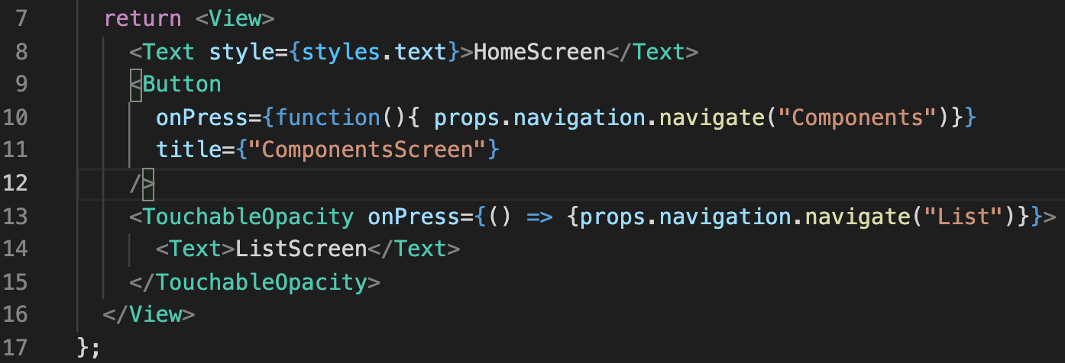
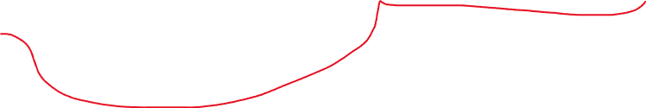
Introduction to React Navigation
If you said “exactly how we did it just a second ago” – you’d be right!
Something like this, yeah? We’re just navigating to List now instead of Components.
Also, don’t be confused by the difference between
function(){…}
And
() => {…}
Remember: just two different ways of defining a function!

Slide 77
Introduction to React Navigation
This is the components screen!
I love mobile programming!!
It is the only time I feel alive
And with that, TADA!
We did it! We have a multiscreen app!
We can go back and forth between screens with ease!
ComponentsScreen
ListScreen
Ben
Ted
Chris
Matt
James

Slide 78
Introduction to React Navigation
Now, one last quick thing…
Does anyone remember what destructuring referred to, in JavaScript land?

Slide 79
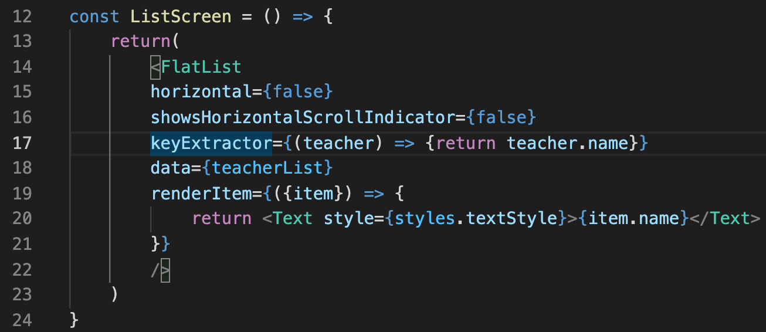

Introduction to React Navigation
We saw it when we chatted about FlatList.
In our renderItem prop, the object passed in as an argument had a bunch of properties that we didn’t necessary need.
Most of the good stuff was in a property called item.
So we used the { } to destructure that object, and only pass in that item object.

Slide 80




Introduction to React Navigation
If you want, you could do the same thing here!
We are destructuring the props object, essentially only passing in the navigation object.
That then enables us to reference navigation directly here, without having to specify props first!

Slide 81
Introduction to React Navigation
True, it isn’t *that* different!
But it does make it slightly prettier?
It is up to you!

Slide 82
Introduction to React Navigation
OK! We now know how to work some simple navigation and make multi-screen apps!
Our skills are growing by the day!
Next time, we’ll dig in deeper to the promise of a notion that was introduced today: configuring our own hand-made components with custom props!
See ya then!

Slide 83
Today’s Agenda
Setting Some Goals
Working with Button
Working with TouchableOpacity
Introduction to React Navigation.

